Slide 1

BLOOD BANK MANAGEMENT SYSTEM
Presentation by Dhruv Gujar

Slide 2







Project Agenda
Understand the blood bank problem domain
Explore the dataset and database structure
Analyze blood availability and hospital
demand using SQL
Identify shortages, risks, and inefficiencies
Derive data-driven insights for better
decision-making
Suggest operational improvements based on analysis
Summarize findings and conclude the
project

Slide 3
project overview
This project focuses on analyzing a Blood Bank Management System using SQL.
The objective is to understand blood availability, hospital demand, donor behavior, and inventory status through data analysis.
A relational database was designed containing information
about donors, blood donations, inventory, hospitals, recipients, and blood requests.
SQL queries were used to perform data aggregation, filtering,
and joins to answer real-world healthcare business questions. The analysis helps identify blood shortages, rare blood group risks, expired inventory, and high-demand hospitals.
Insights derived from the project support better decision-
making and operational planning for blood banks.

Slide 4
problem statement
Blood banks play a critical role in healthcare by ensuring the timely availability of safe blood for patients. However, managing blood inventory is challenging due to fluctuating hospital demand, limited availability of rare blood groups, blood expiry, and quality-related rejections. Inefficient tracking of donor information, inventory status, and hospital requests can lead to shortages, wastage, and delayed patient care.
This project aims to analyze blood bank data using SQL to identify availability issues, demand patterns, operational risks, and areas for improvement to support better decision-making and efficient blood bank management.

Slide 5
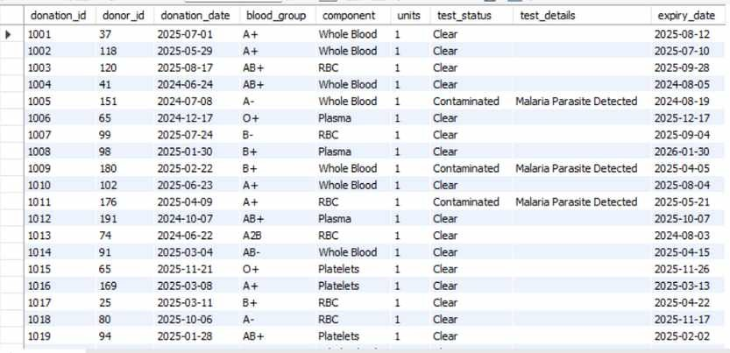
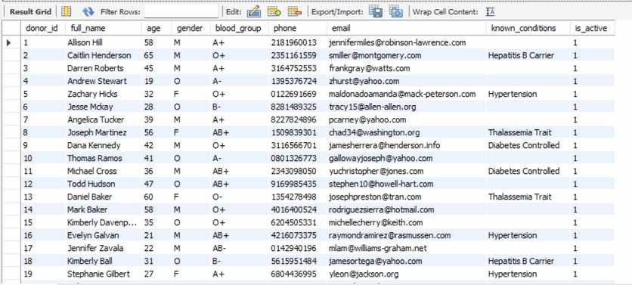
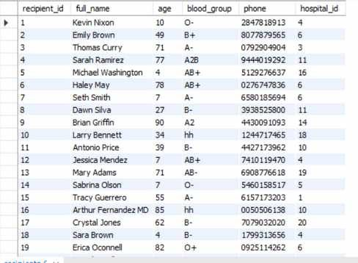
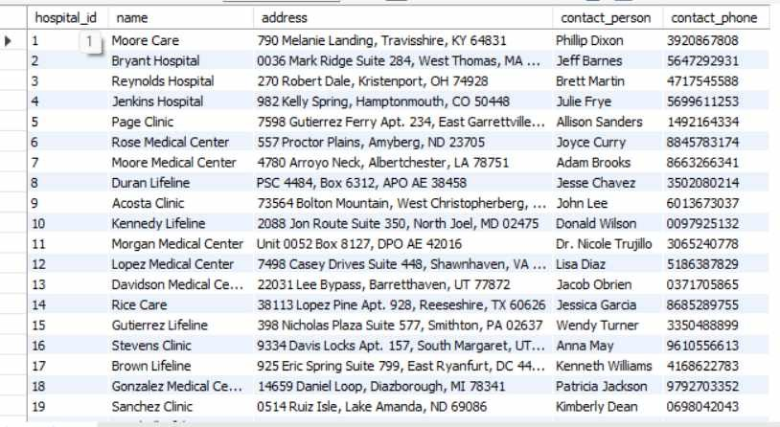
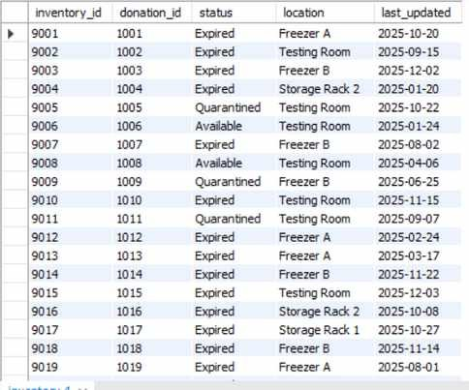
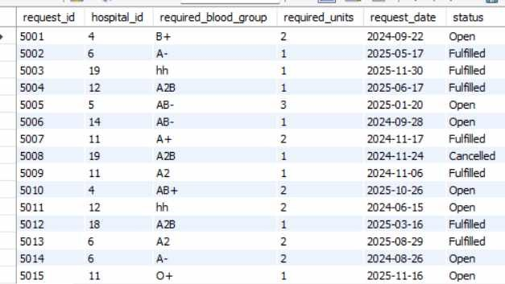
tables

Slide 6
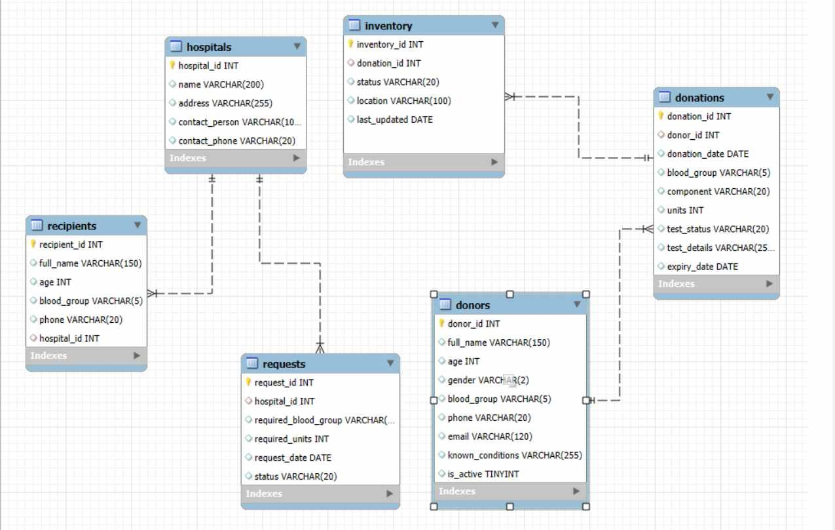
ER Diagram

Slide 7
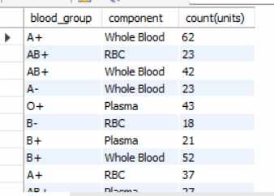

1. How many blood units are currently available for each blood group and component?

Slide 8
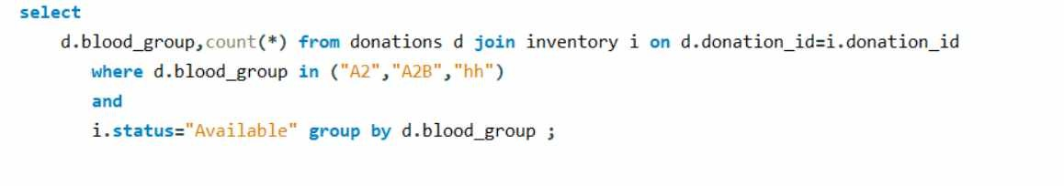

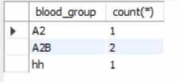
2. Are there any blood groups (including rare groups like A2, A2B, hh) that are critically low in stock?

Slide 9
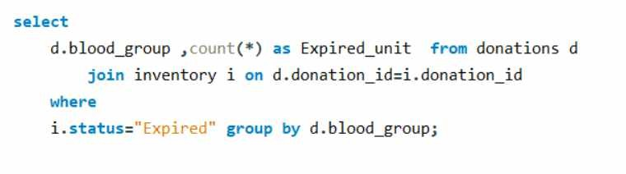
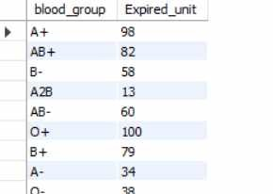

3.How many blood units have expired and how many are nearing expiry (within the next 7 days)?

Slide 10
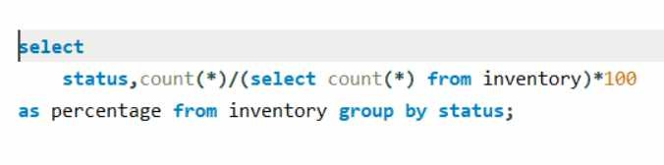

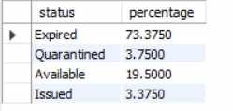
4.What percentage of the total inventory is available, issued, expired, or quarantined?

Slide 11
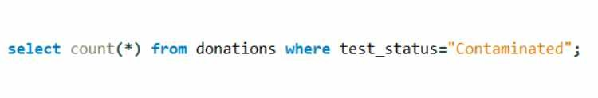


5.How many blood donations failed the quality tests?

Slide 12
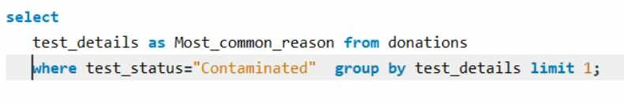


5.What are the most common reasons for blood contamination?

Slide 13
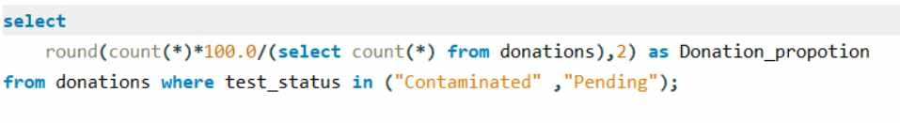


6.What proportion of total donations are marked as contaminated or pending testing?

Slide 14
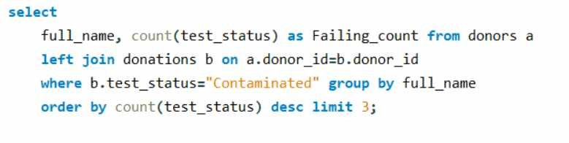


7.Are there donors whose donations repeatedly fail quality tests?

Slide 15
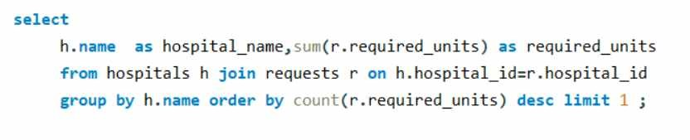

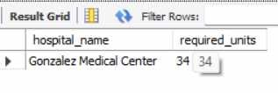
8.Which hospitals request the highest number of blood units?

Slide 16
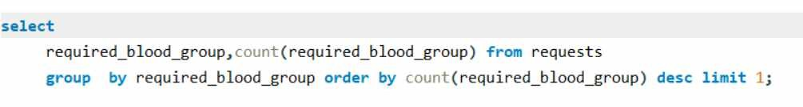

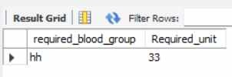
9.Which blood groups are most frequently requested by hospitals?

Slide 17
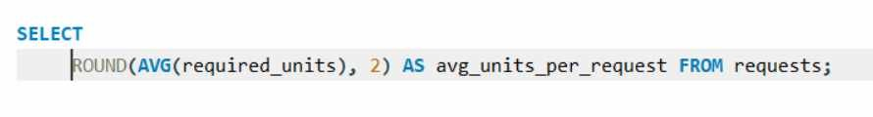


10.What is the average number of units requested per hospital request?

Slide 18
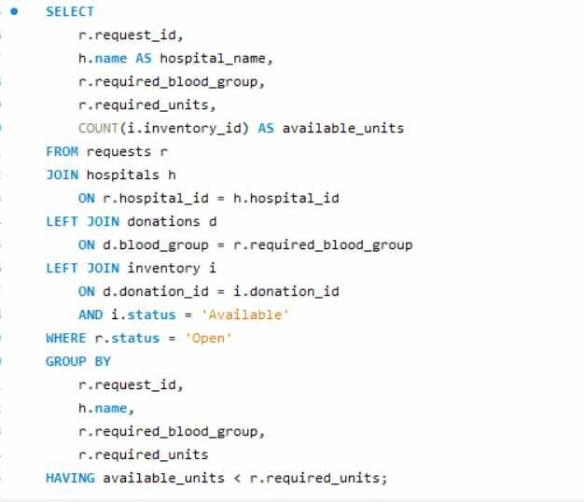

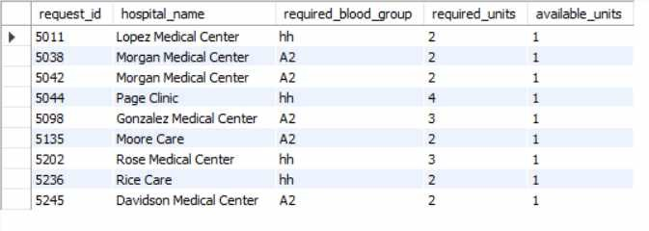
11.Are hospitals requesting blood that is currently unavailable?

Slide 19
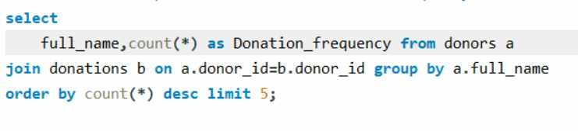

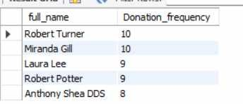
12.Who are the top donors based on donation frequency?

Slide 20
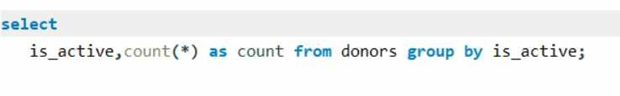


13.How many active vs inactive donors are registered in the system?

Slide 21
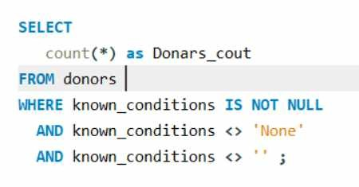


14.How many donors have recorded medical conditions?

Slide 22
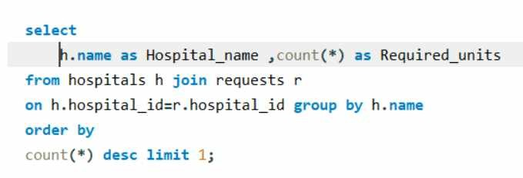


15.Which hospitals request the highest number of blood units?

Slide 23
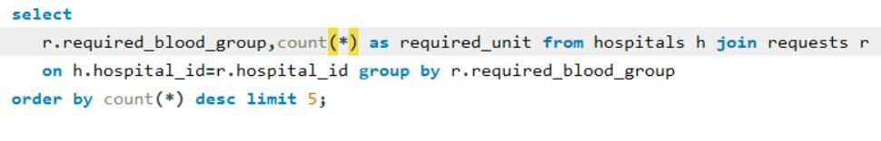

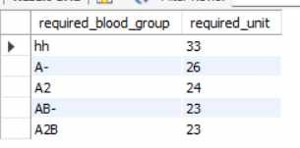
16.Which blood groups are most frequently requested by hospitals

Slide 24


17.What is the average number of units requested per hospital request?

Slide 25
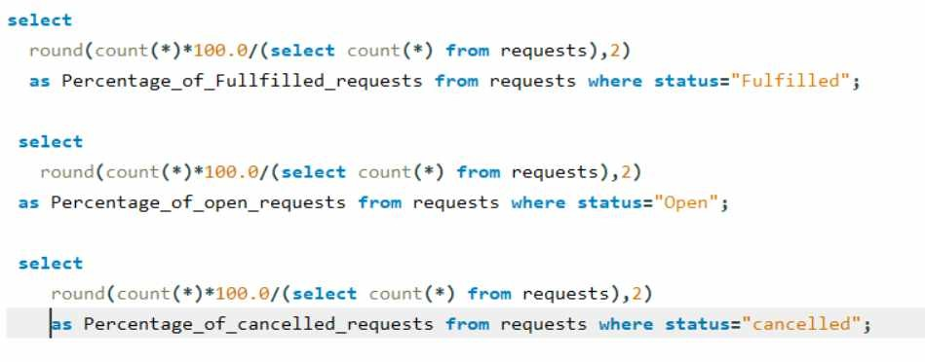



18.What percentage of blood requests are fulfilled, open, or cancelled?

Slide 26
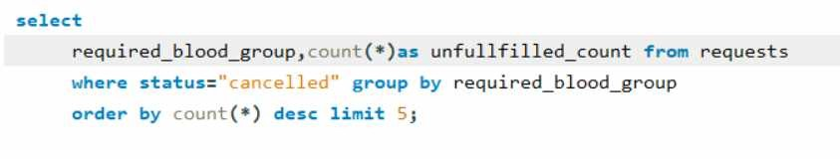

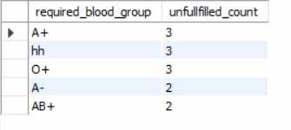
19.Which blood groups have the highest number of unfulfilled requests?

Slide 27
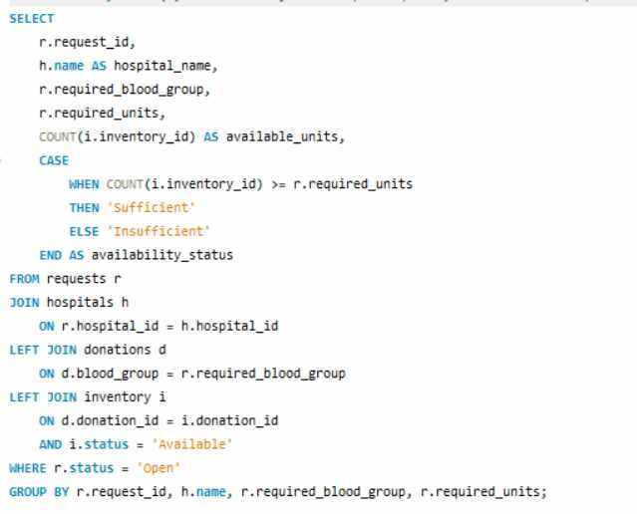

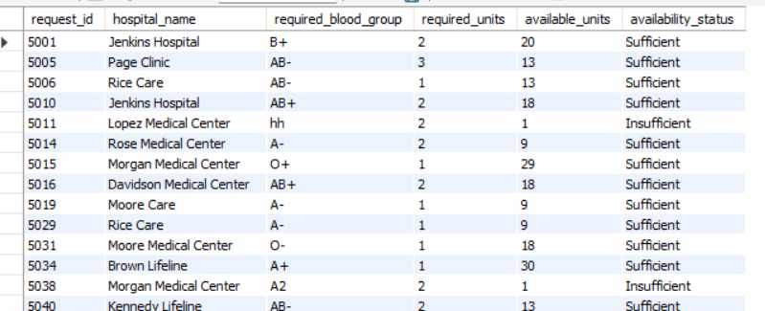
20.For open requests, is sufficient compatible blood currently available?

Slide 28
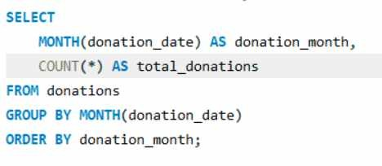

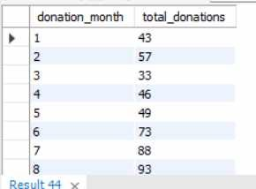
21.How do blood donations vary month-wise?

Slide 29
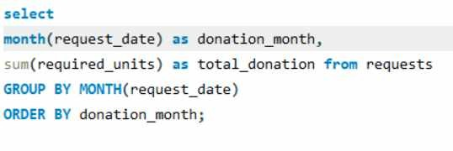
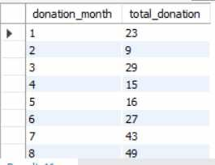
22. Is there a seasonal pattern in blood donation or blood demand?

Slide 30
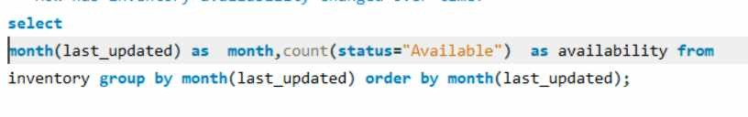

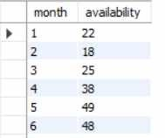
23.How has inventory availability changed over time?

Slide 31
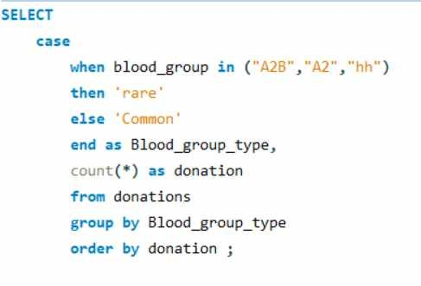


24.Are rare blood groups donated less frequently compared to common groups?

Slide 32


25.What operational improvements can be suggested based on data analysis?
Target rare blood group donors
Reduce blood expiry through better rotation Monitor demand vs availability regularly Expand and diversify donor base
Improve quality screening process Plan seasonal donation drives Prioritize high-demand hospitals Maintain real-time inventory tracking Create emergency donor contact lists Use data for continuous improvement

Slide 33
Conclusion
This project demonstrated how SQL can be effectively used to analyze real-world healthcare data.
The analysis provided insights into blood availability, hospital demand, donor behavior, and inventory status.
Key issues such as rare blood group shortages, expired inventory, and unfulfilled hospital requests were identified. Data-driven findings highlighted the need for better inventory management, targeted donor drives, and demand-based prioritization.
Overall, the project shows how structured data analysis can support efficient blood bank operations and informed decision-making.

Slide 34
Thank You

